Slide 1
CMPE 258 -Homework 2 Asssignment

Slide 2
CMPE 258 – HW Assignment 2 – Part 1
Hello Classification using GCP Examples
Hello Text Data
Hello Video Data
Hello Custom Data
Hello Image Data
Hello Tabular Data
Tripura Chandana Gayatri Gorla
Spring - 49

Slide 3
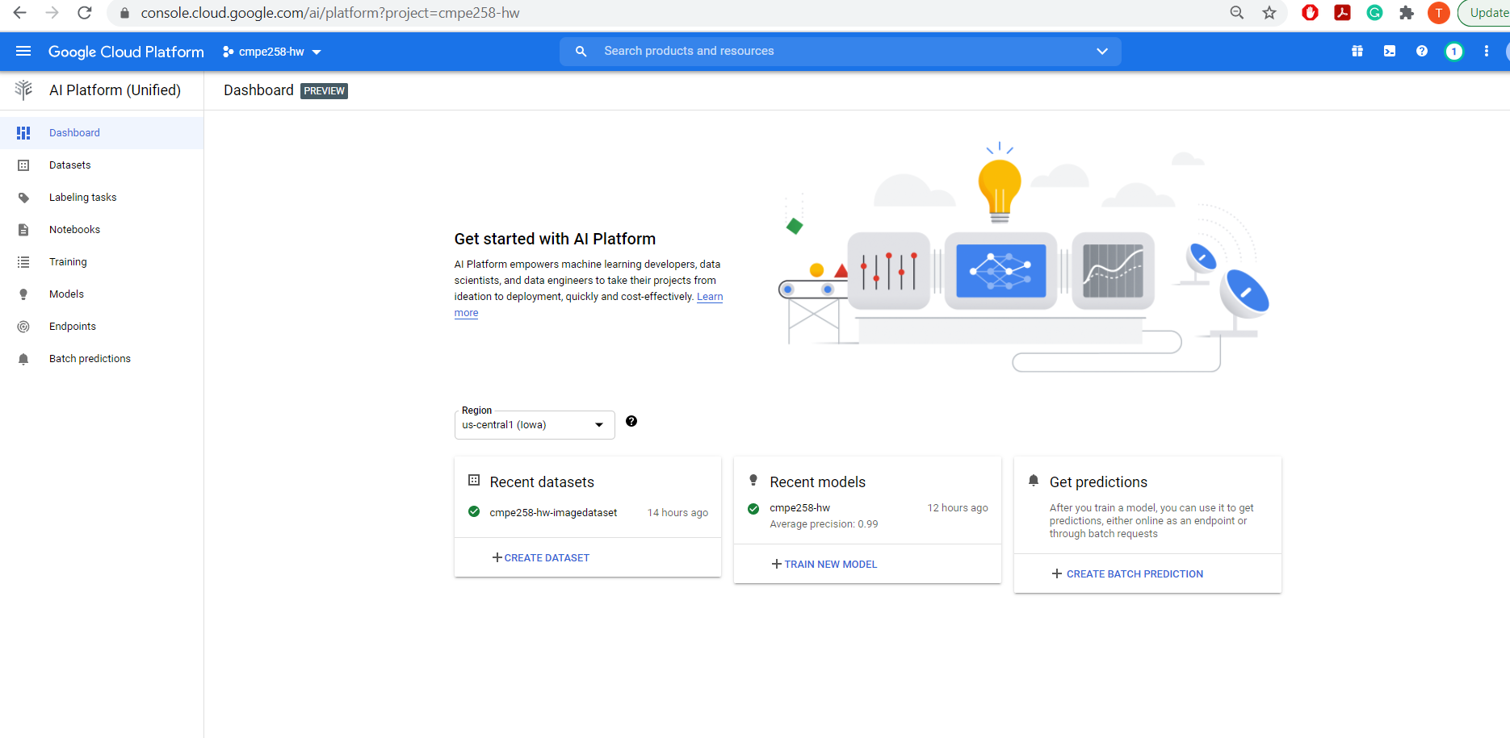
Hello image data: Setting up your project and environment
After creating and setting up the GCP account, and setting up environment required and as guided in the tutorial, Create dataset and imported files of flower categories.

Slide 4
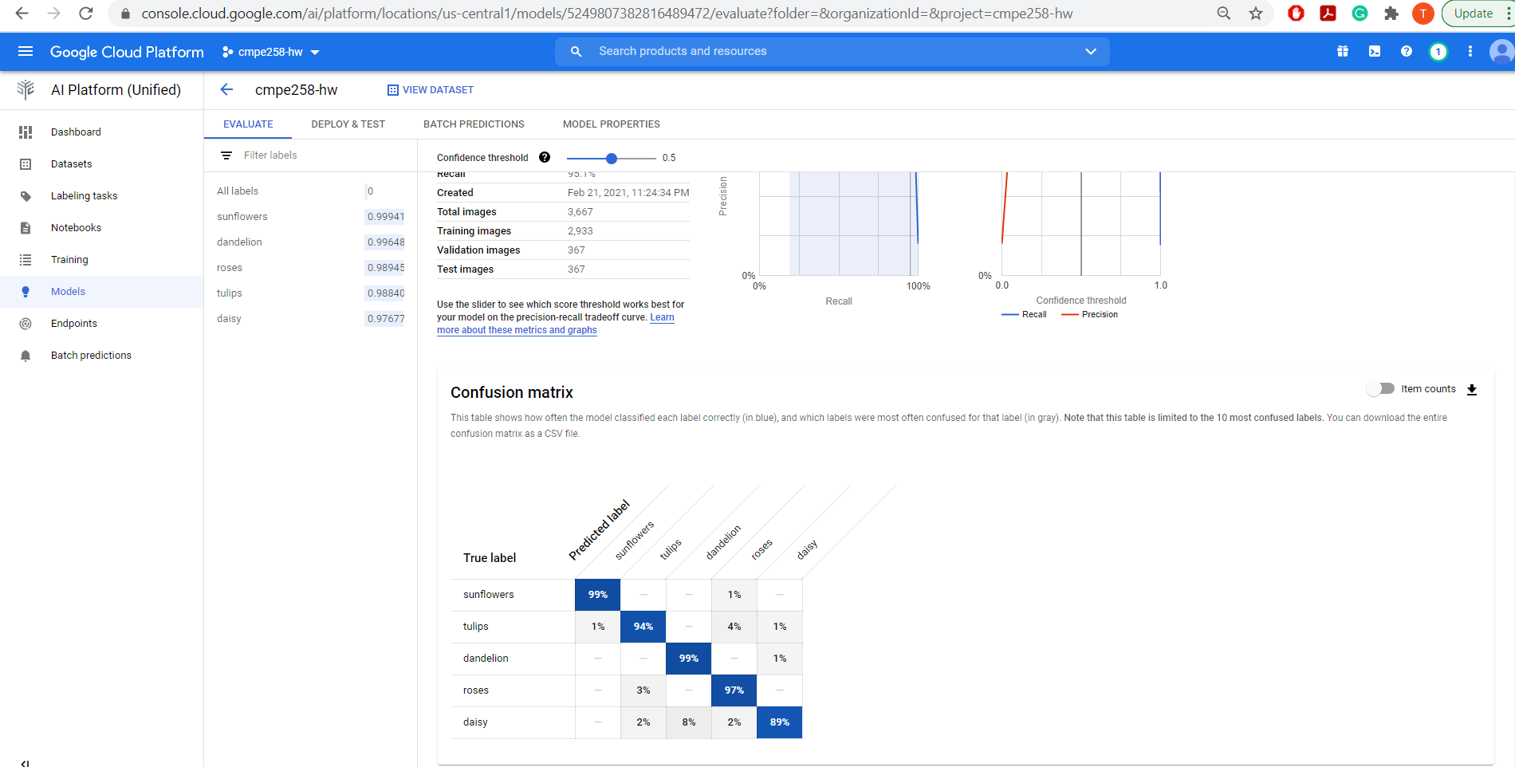
Creating an image classification dataset and importing images

Slide 5
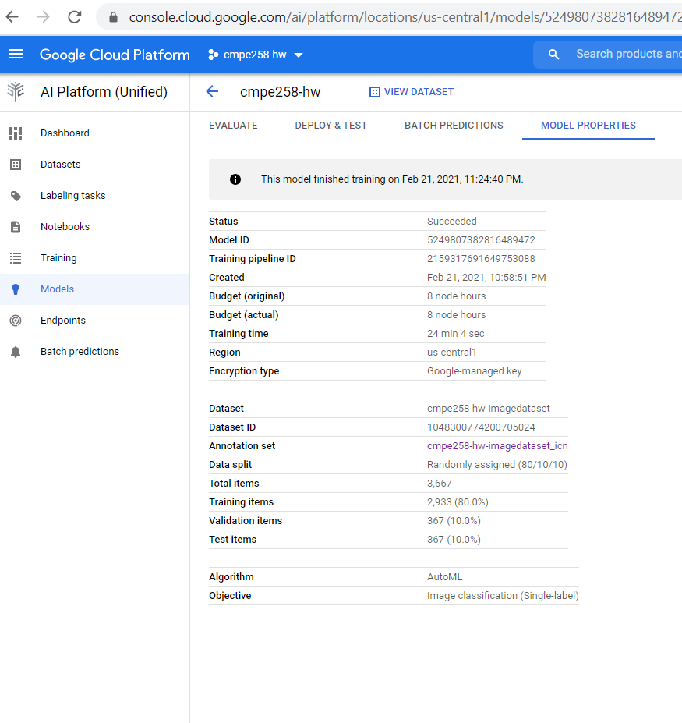
Training an AutoML image classification model

Slide 6
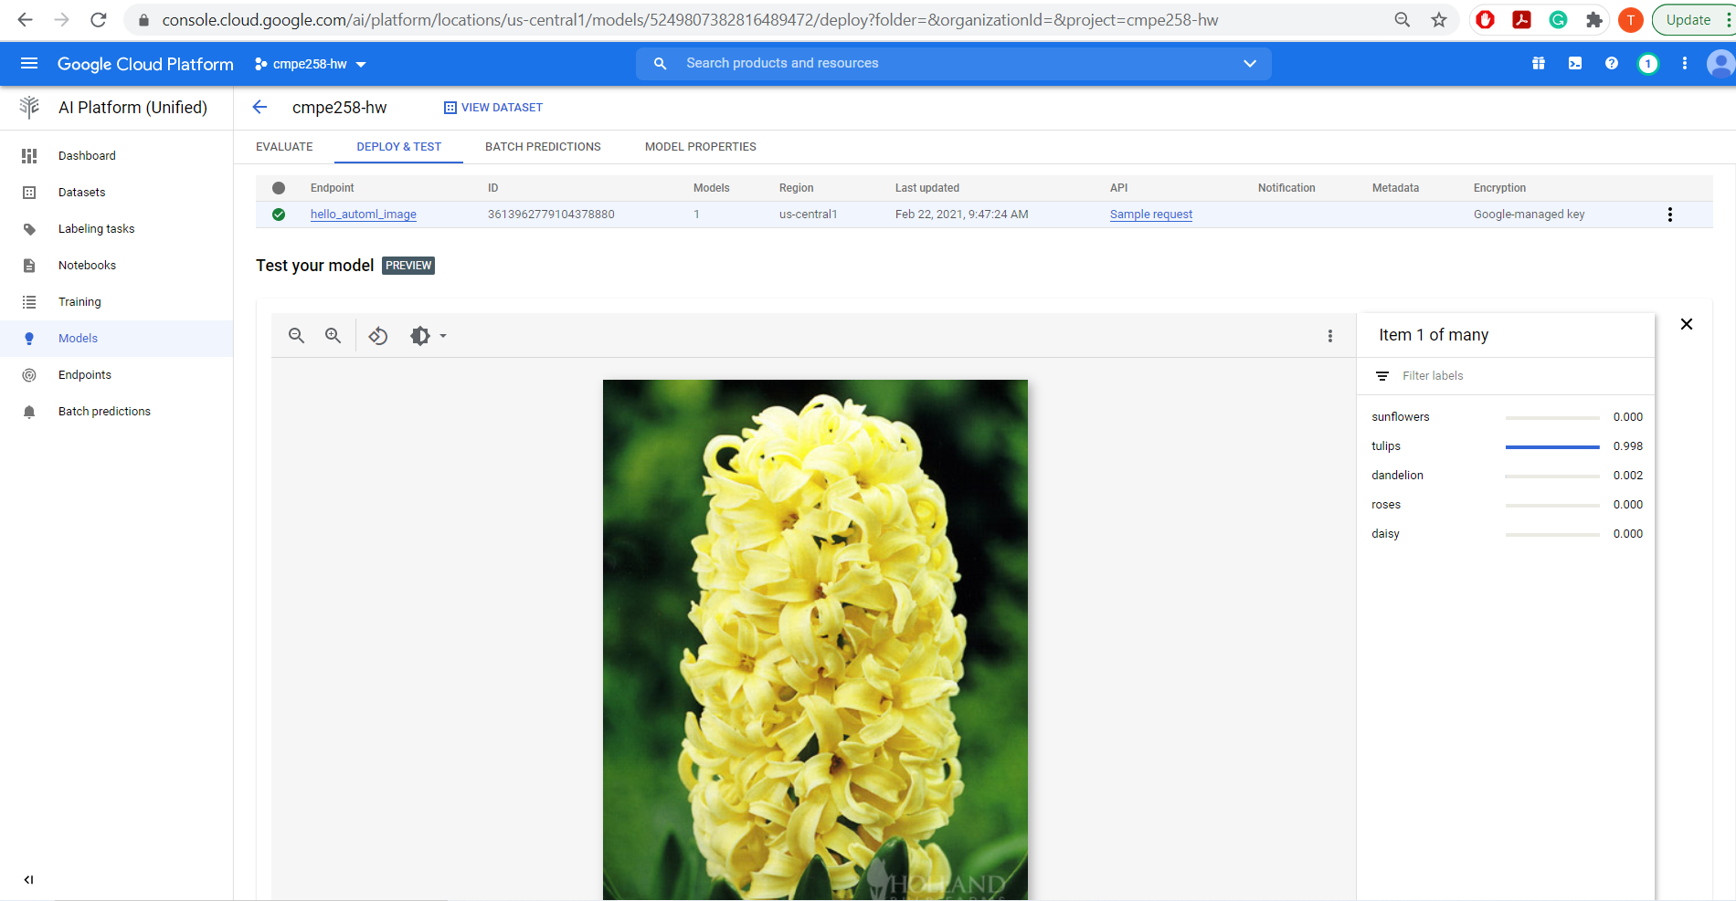
Deploying a model to an endpoint and send a prediction
Model successfully classified image data into appropriate categories. Classified tulip as tulips and hyacinth which comes under tulip family as tulip.

Slide 7
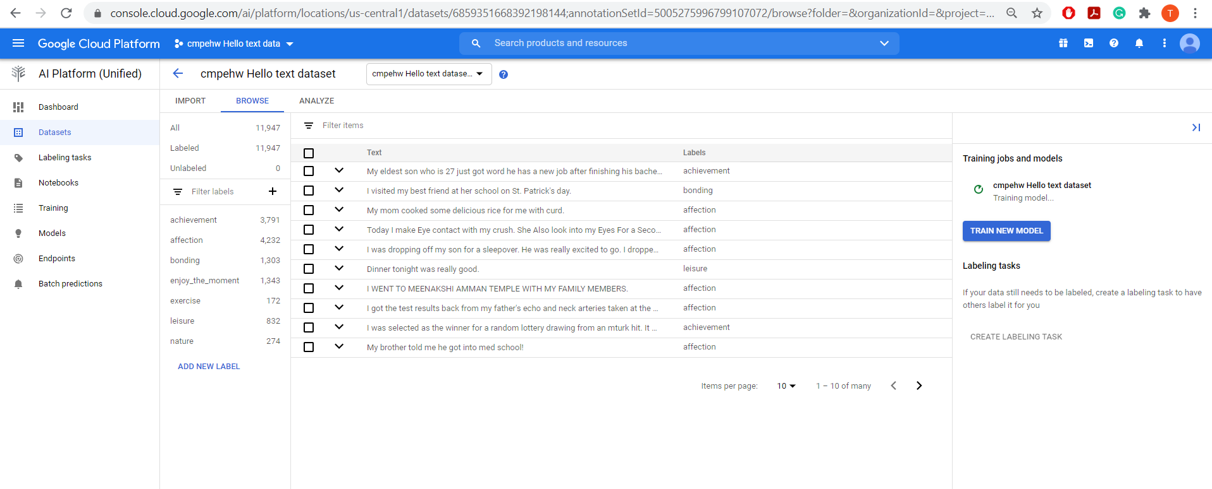
Hello text data: Creating a text classification dataset and importing documents

Slide 8
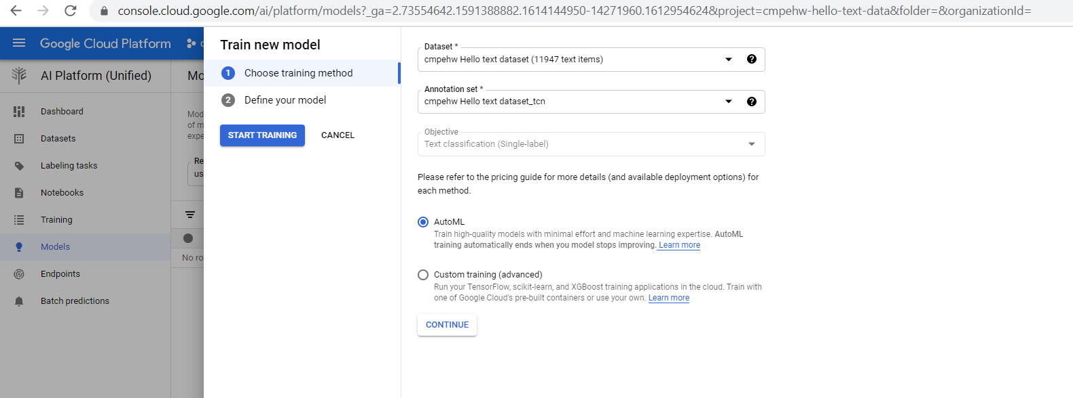
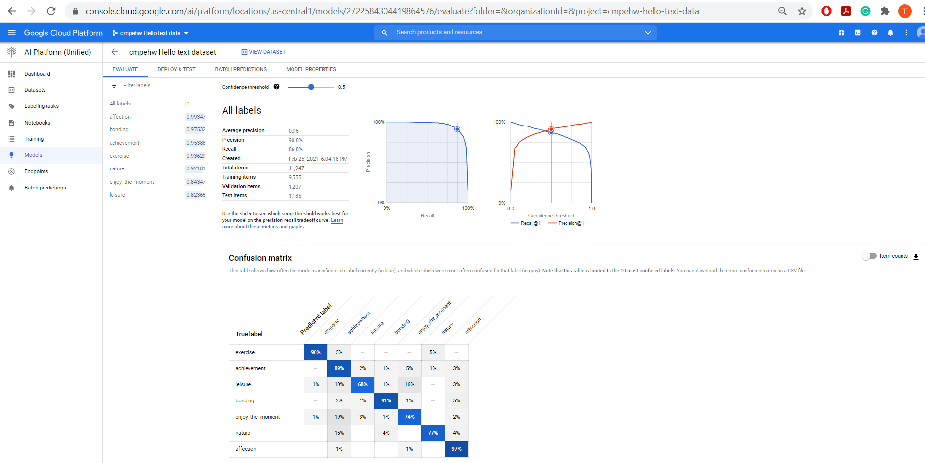
Training an AutoML text classification model

Slide 9
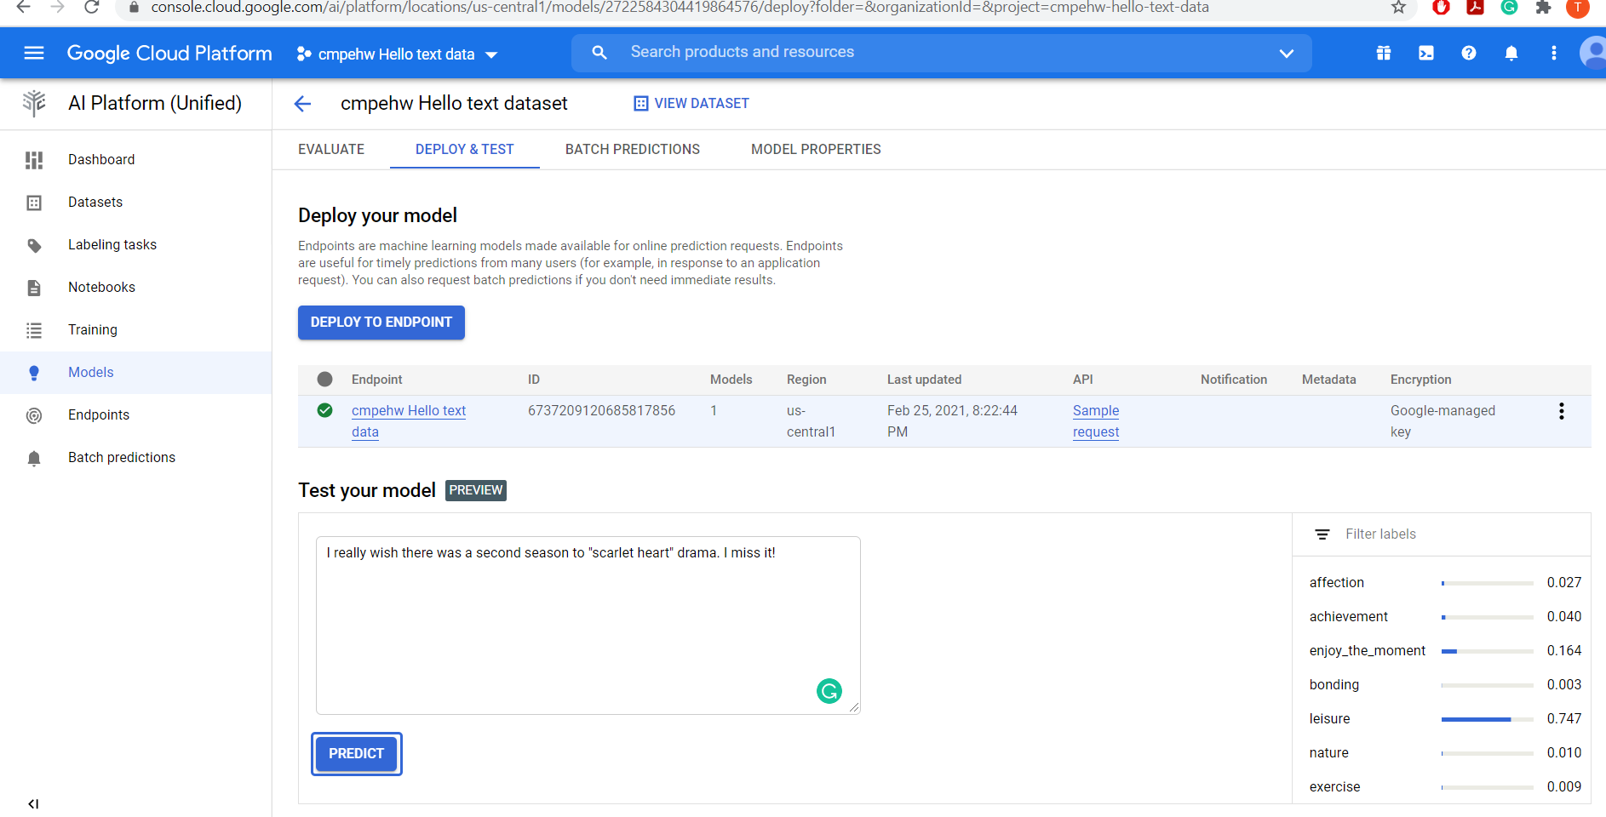
Deploy model to an endpoint and send a prediction

Slide 10
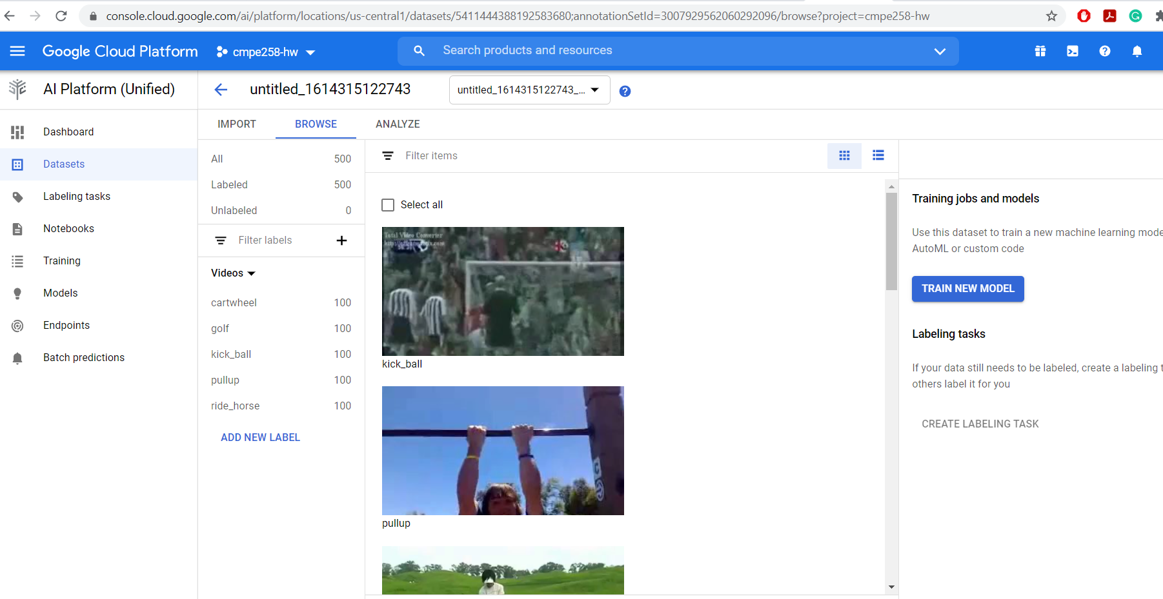
Hello video data: Creating a video dataset and importing videos

Slide 11
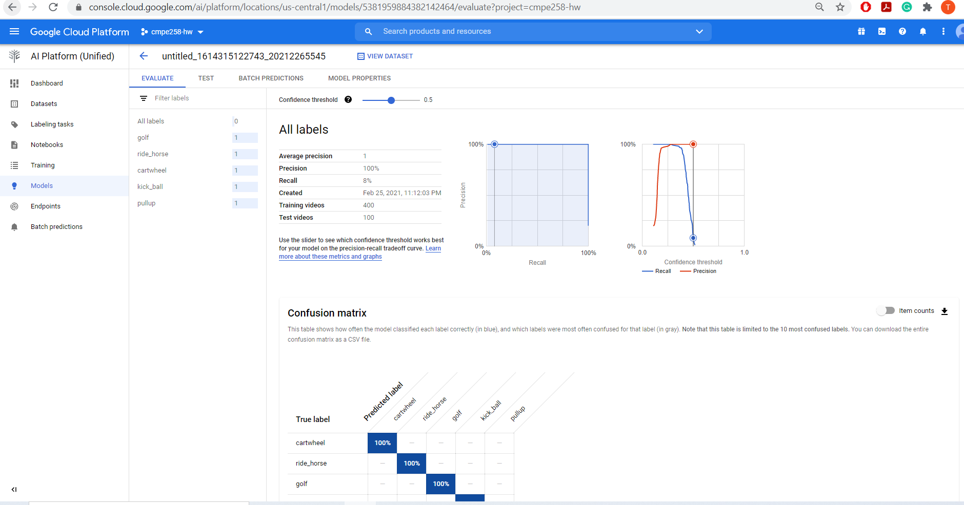
Training an AutoML video classification model

Slide 12
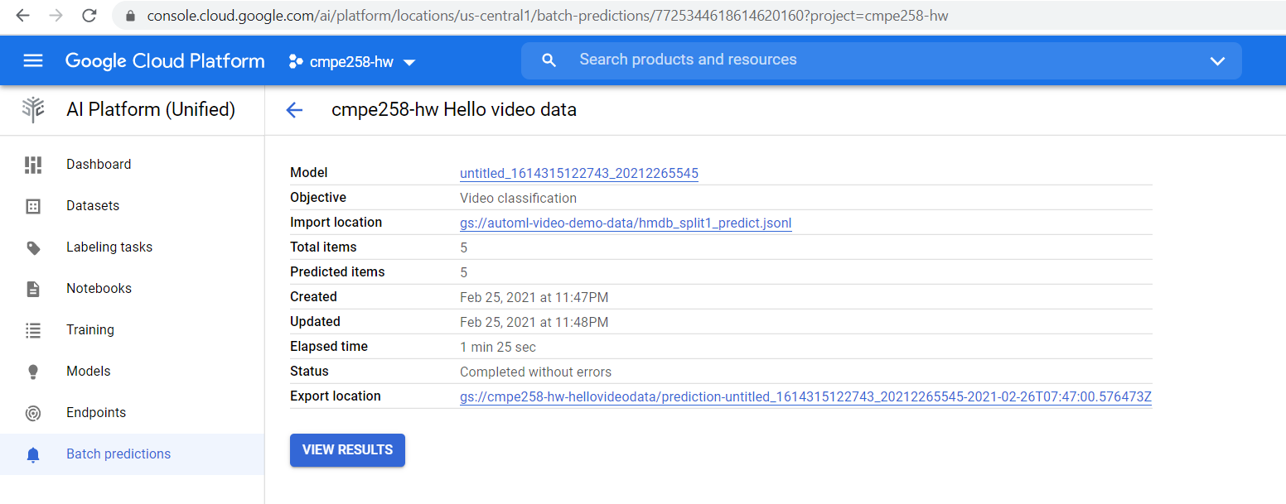
Using a model to make batch predictions

Slide 13
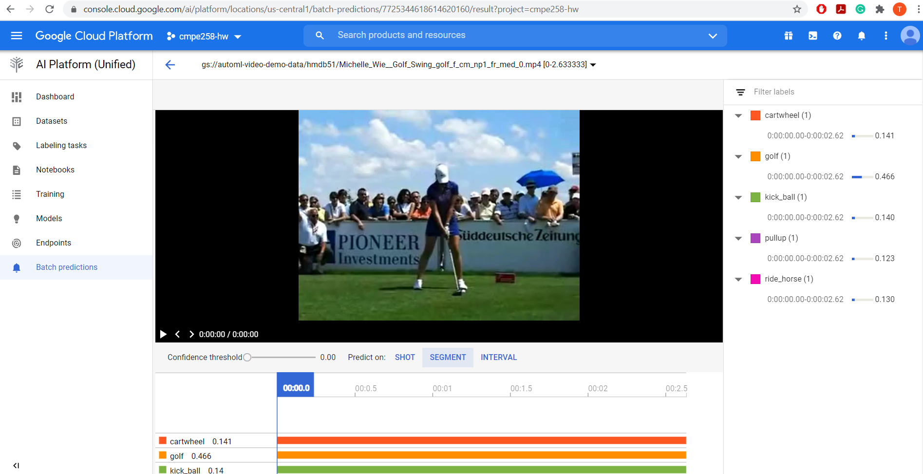
Using a model to make batch predictions

Slide 14
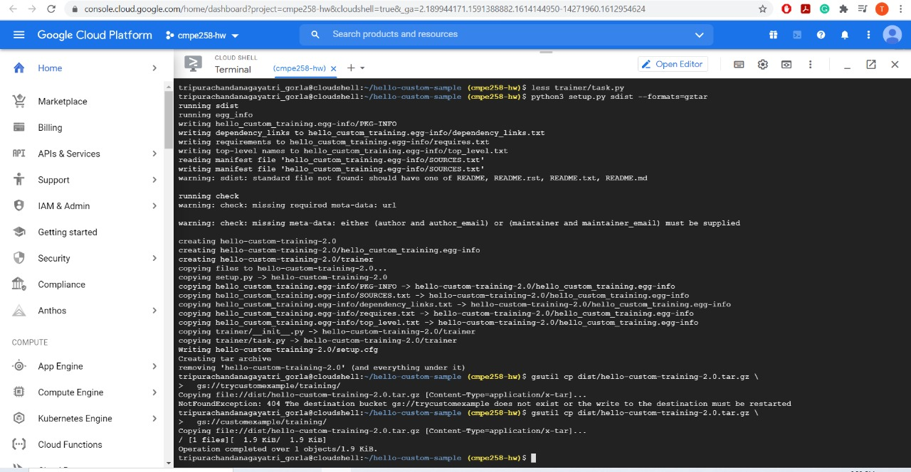
Hello custom training: Setting up your project and environment

Slide 15
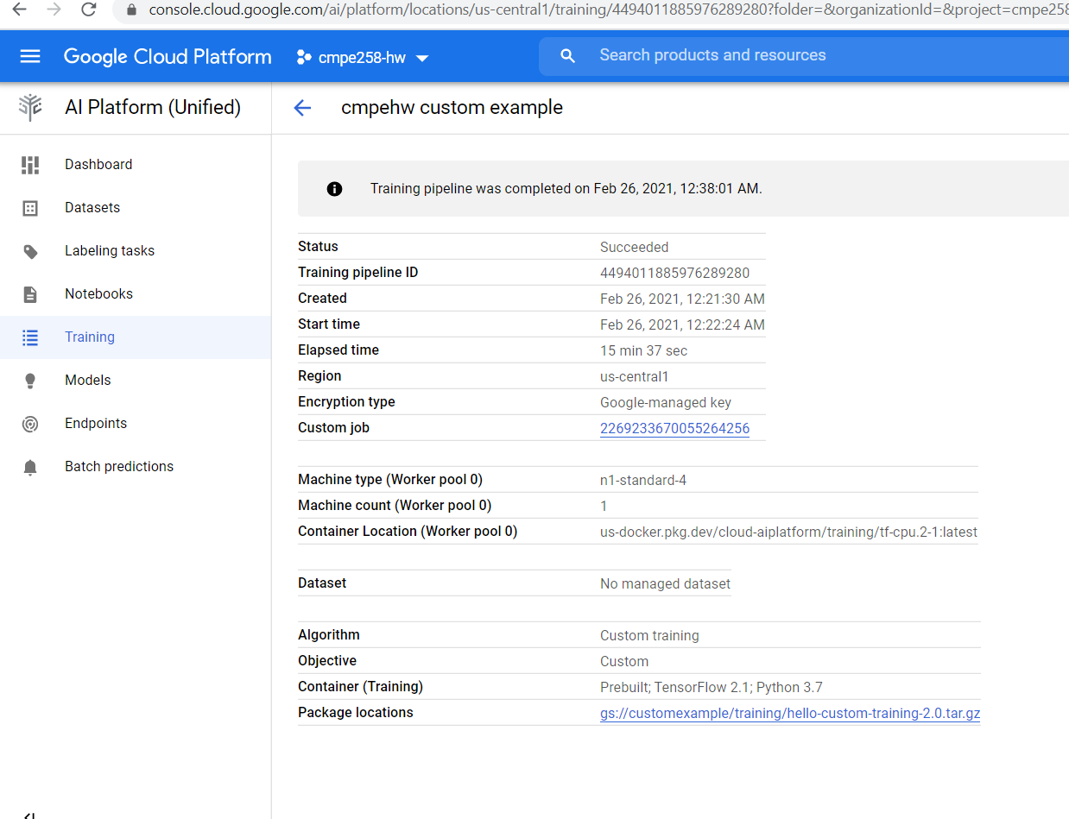
Training a custom image classification model

Slide 16
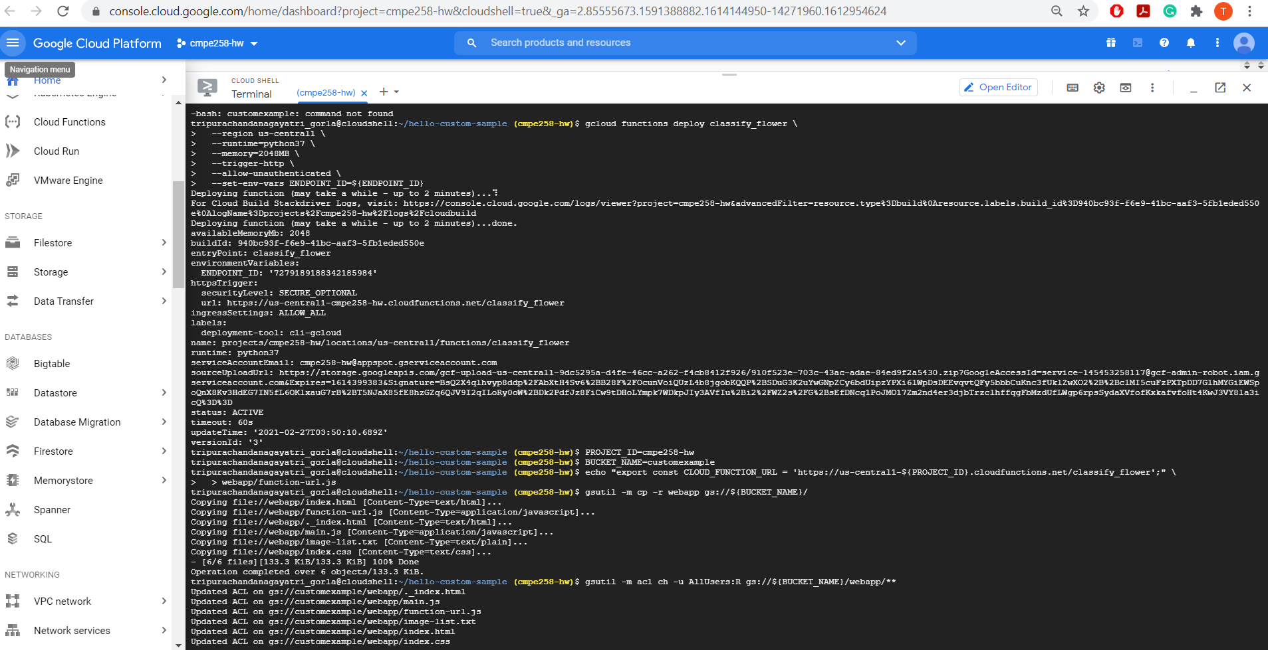
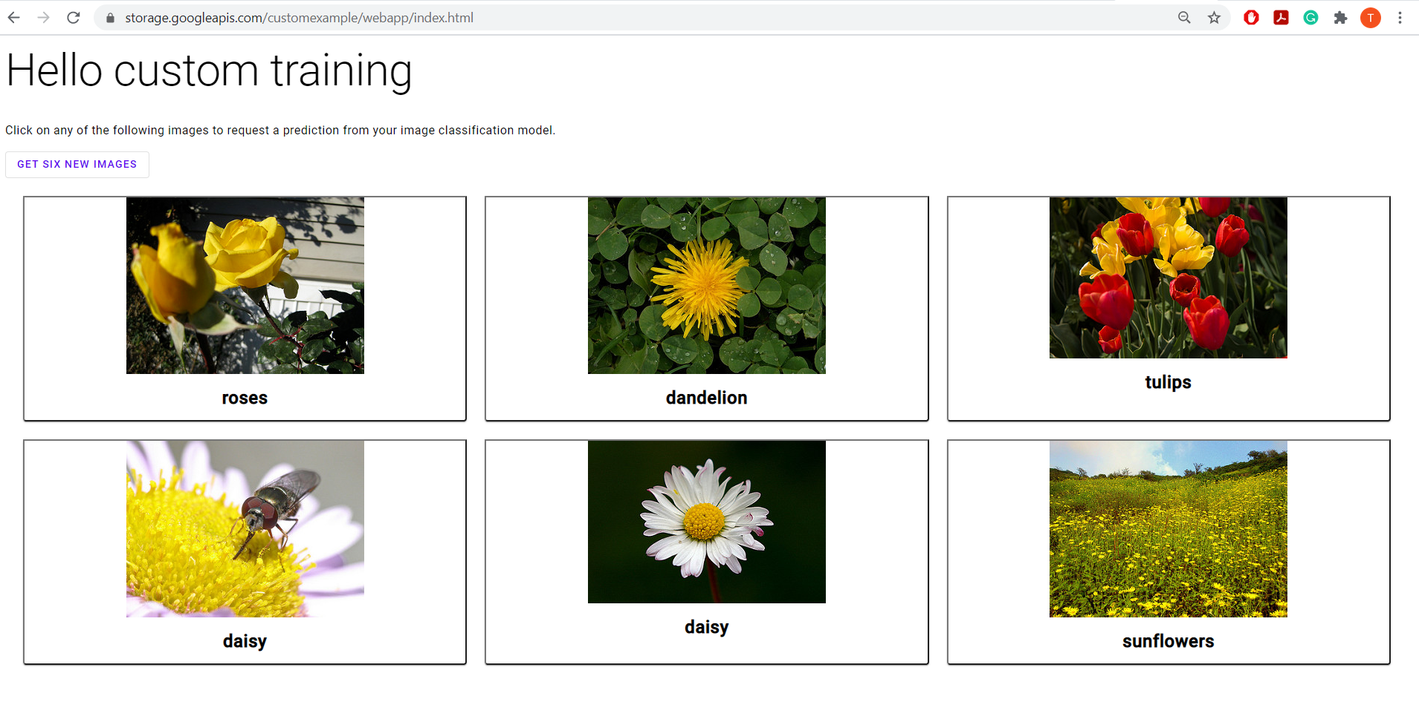
Serving predictions from a custom image classification model

Slide 17
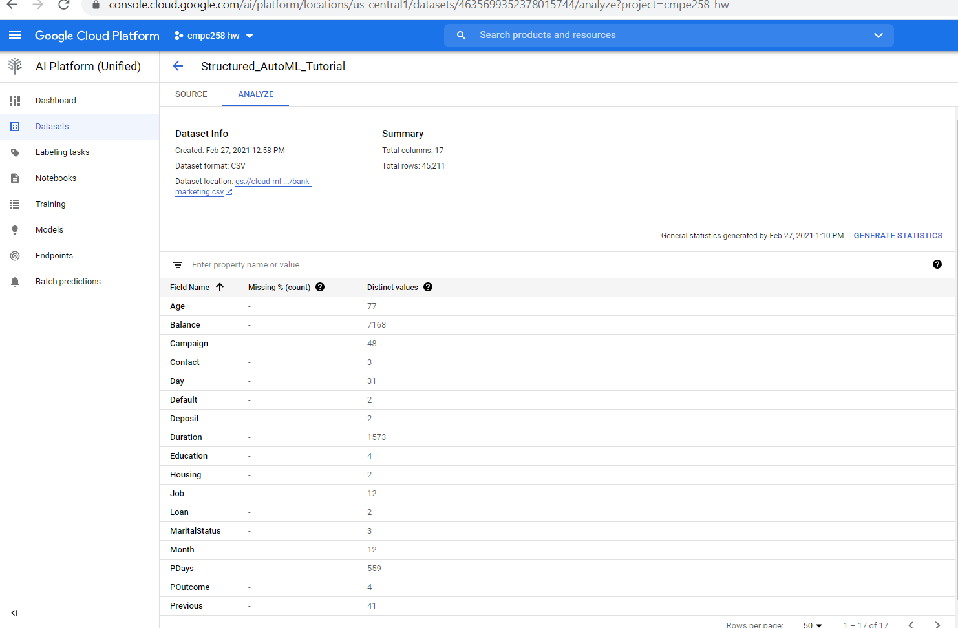
Hello tabular data: Creating a dataset and training an AutoML classification model

Slide 18
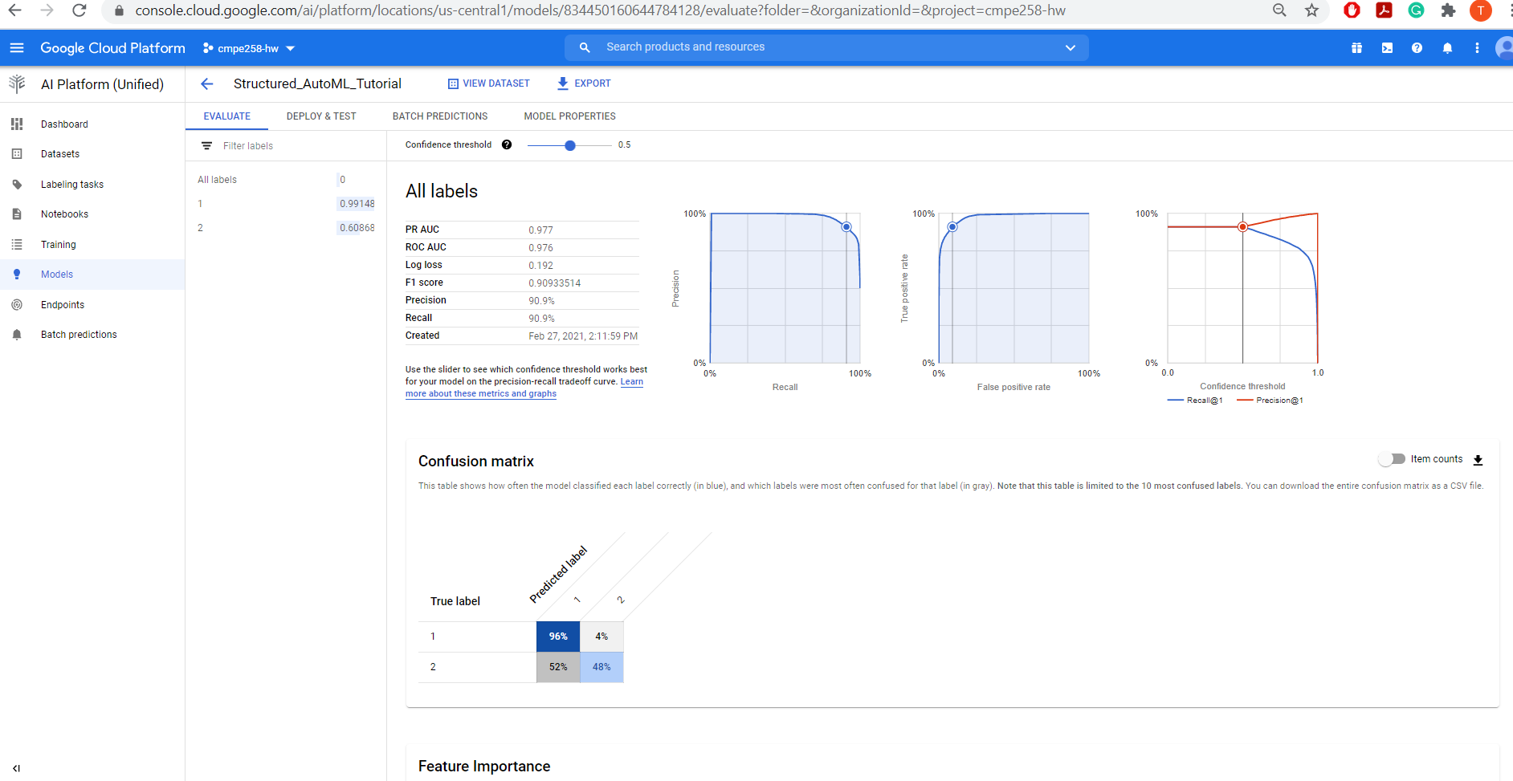
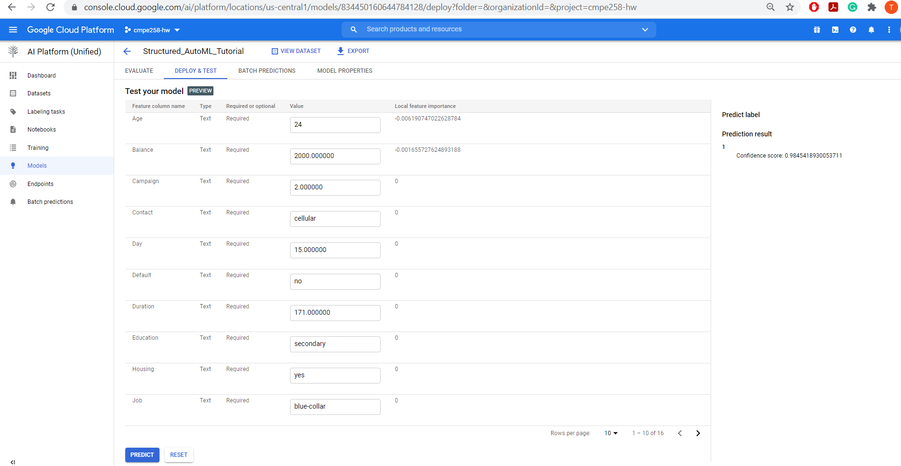
Deploying a model and requesting a prediction

Slide 19
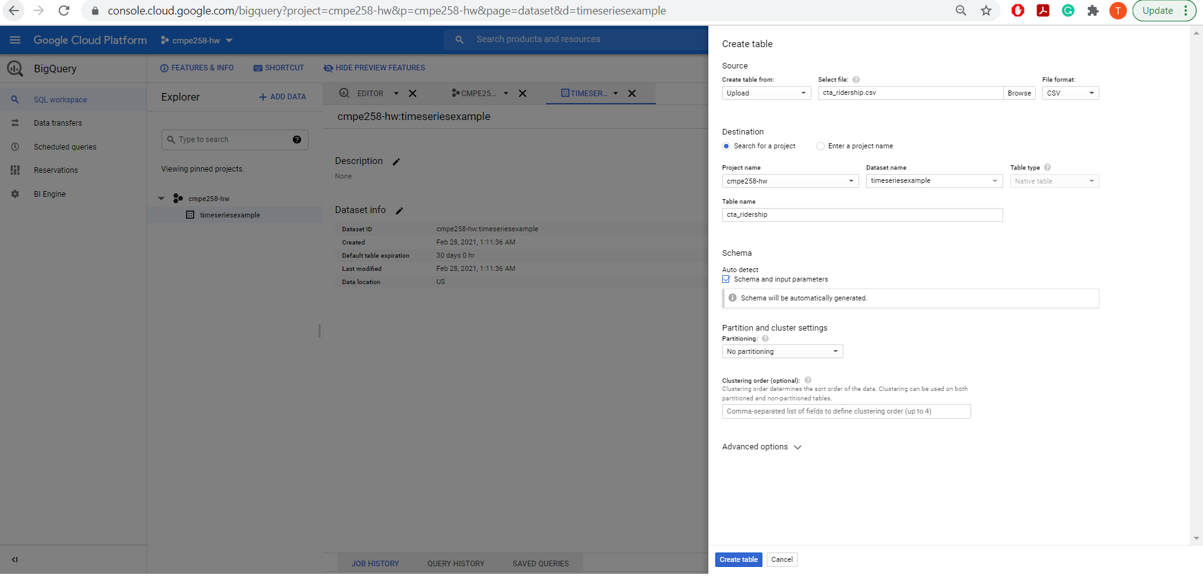
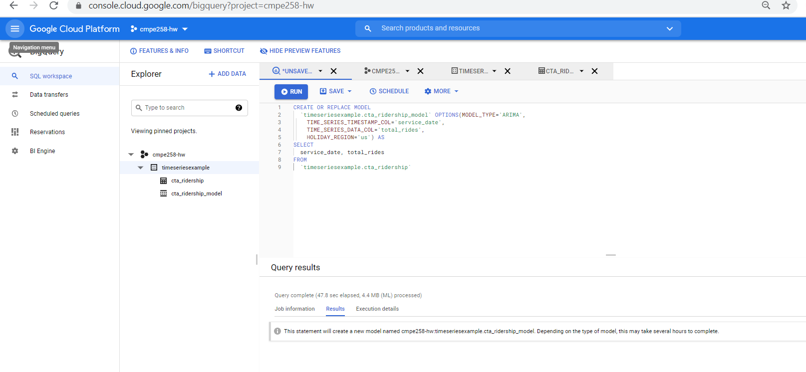
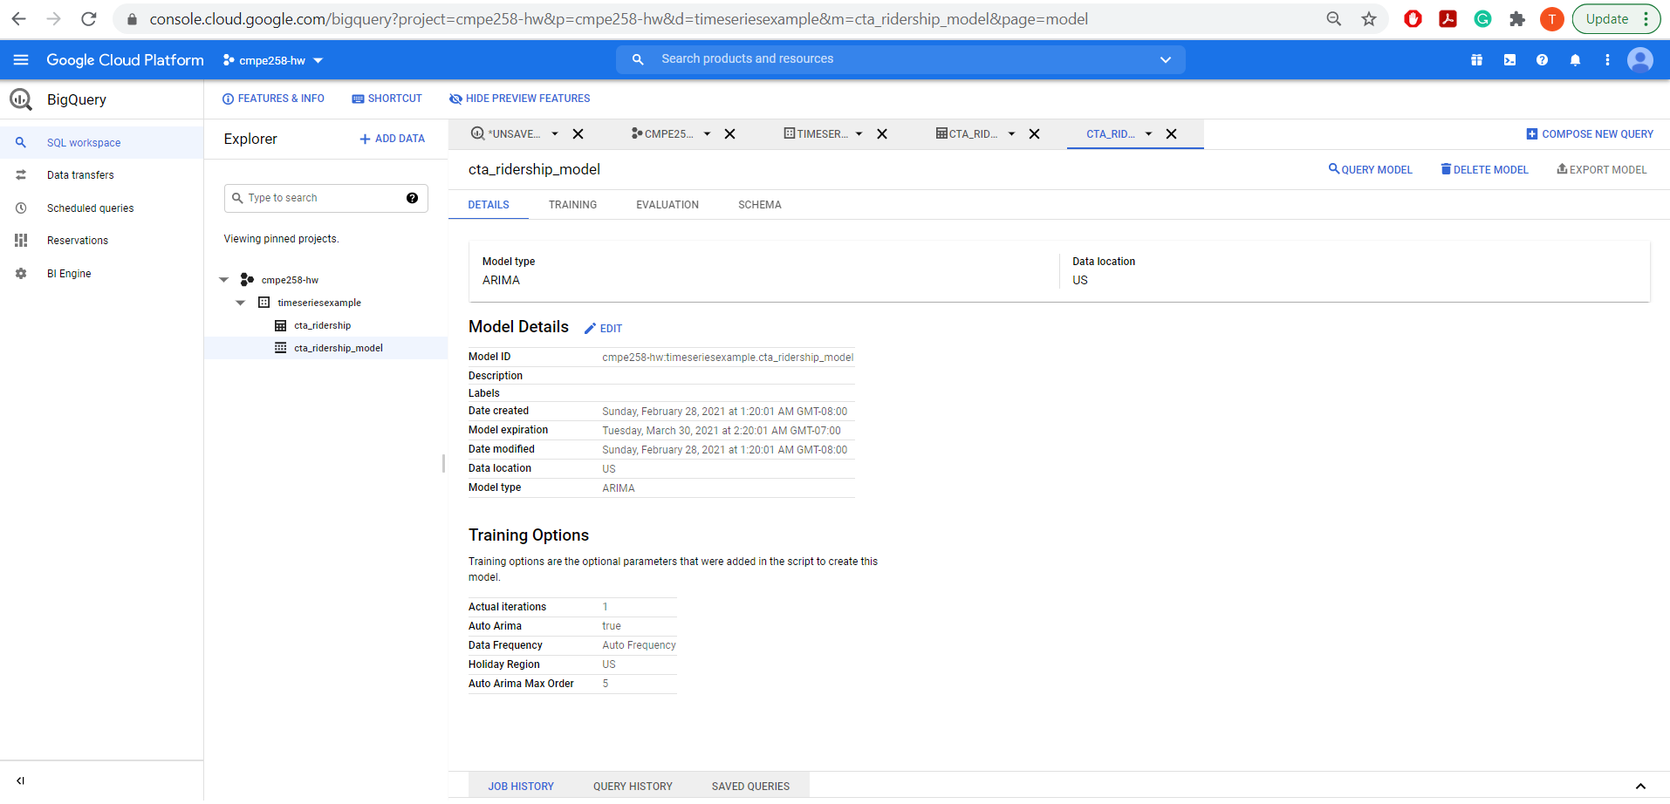
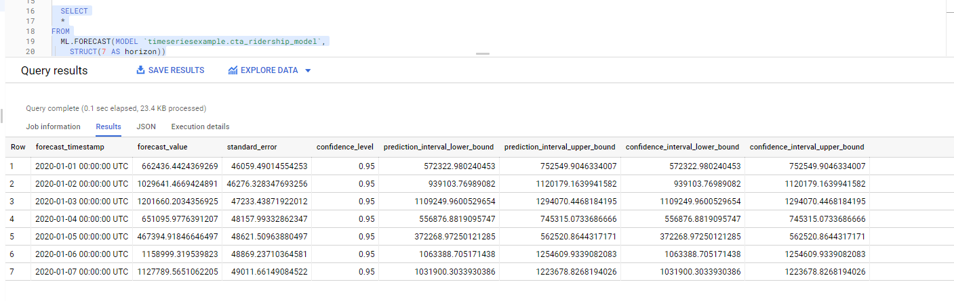
Time Series Example – Assignment Part 2

Slide 20
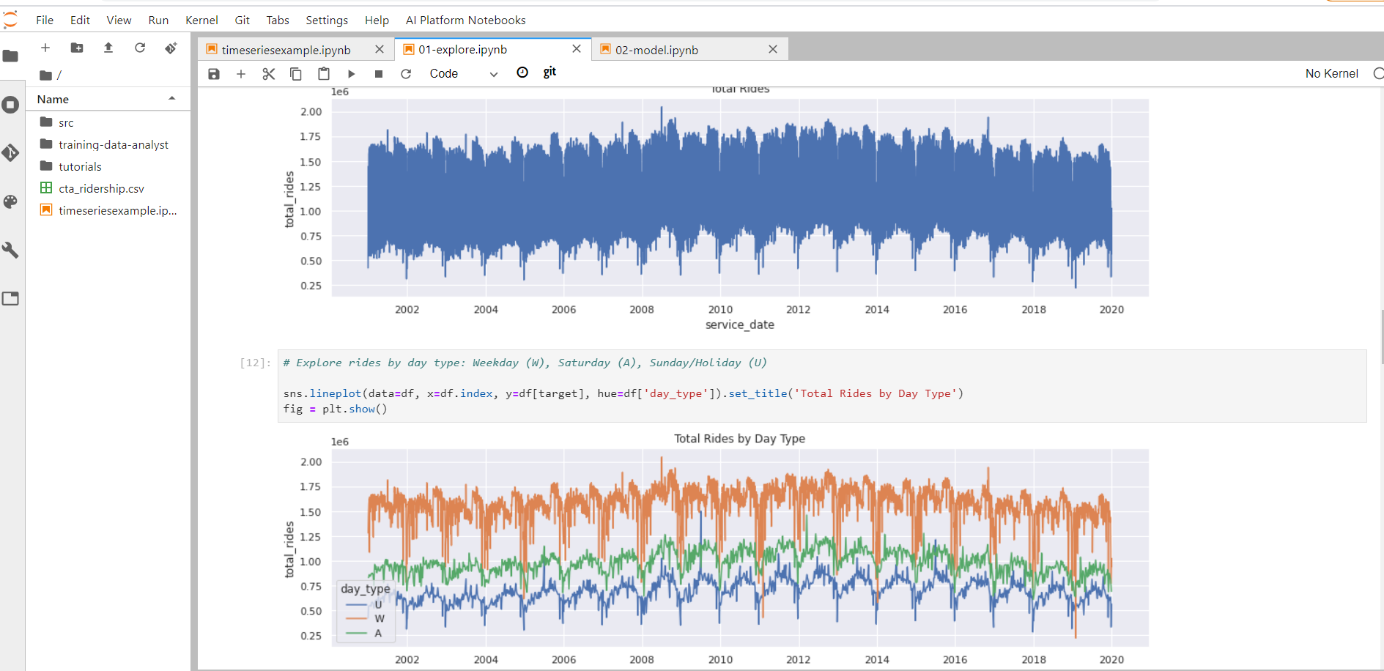
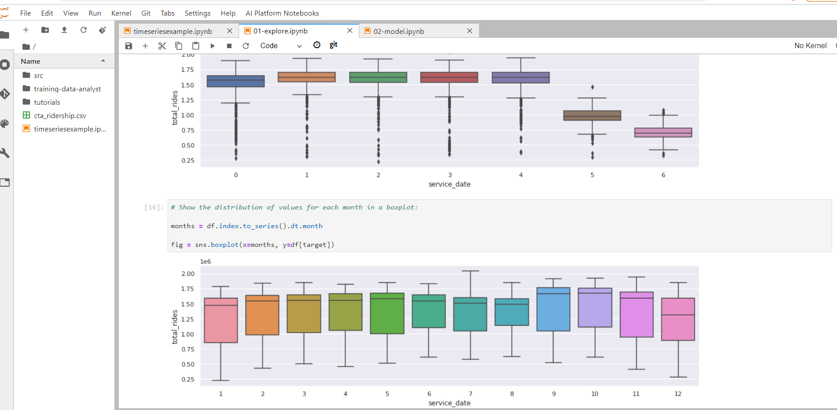
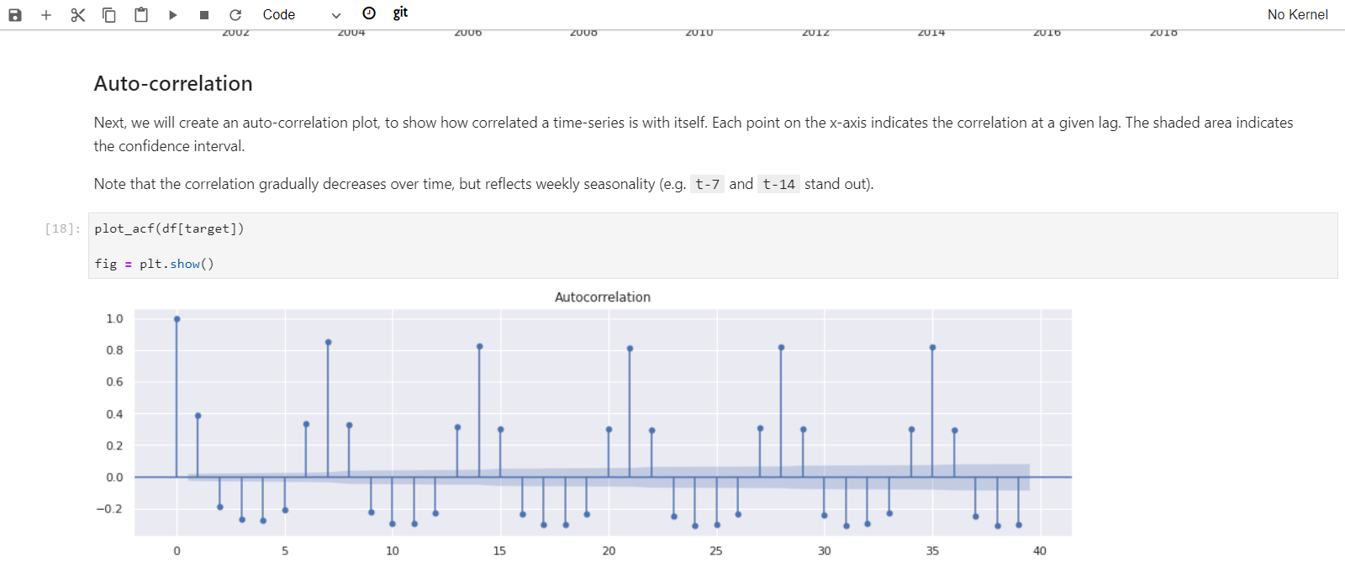
Time Series Example – Assignment Part 2

